Slide 1

Northwest Arkansas Rental Housing Market Analysis
Grant Jackson

Slide 2

Introduction
Analyzing the NWA rental housing market using microeconomic principles to understand pricing dynamics and market efficiency better
Primary Objectives:
Examine relationship between property size and rental rates
Analyze geographic variation in rental prices
Uncover possible seasonal patterns in the market
Evaluate the independent value contribution of bedrooms available

Slide 3
Dataset Description
3,487 rental property observation from Washington County
Time period: 2017 – 2023
Key Variables: Address, Zip Code, Town, List Price, Deposit, Date Available, Total Beds, Heated Square Footage, Sold Price

Slide 4
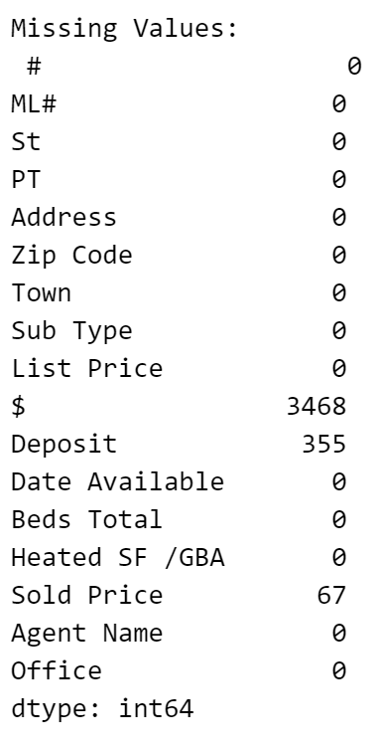
Data Quality Issues Identified
Missing values in observations under Deposit and Sold Price columns
Duplicate listings:
1099 instances of properties in more than one listing observations

Slide 5

Data Cleaning + Processing
Date Standardization:
Converted Date Available column to consistent datetime format
Created additional temporal features with month, year, season, and day of week columns
Missing Values:
Determined observations with missing values are not necessary to drop for future analysis
Handling Duplicate Values:
Identified duplicates based on address, town, heated square footage, and bed total
Created duplicate indicators

Slide 6
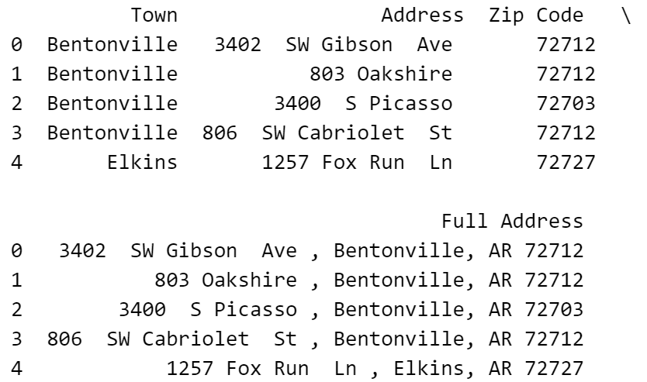
Data Cleaning + Processing
Price Columns:
Converted List Price, Deposit, Sold Price to numeric values
Removed any dollar signs and commas
Square Footage:
Converted Heated SF column to numeric values and removed any text qualifiers
Location Data:
Standardized city names
Created consistent address format with address, town, and zip code

Slide 7
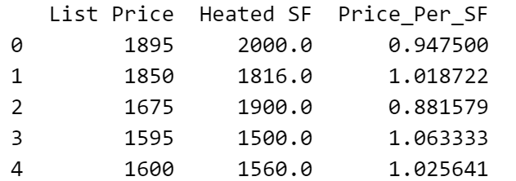
Feature Engineering
Created price metrics for later analysis:
Price per square foot (List Price / Heated SF)
Seasonal Indicators will be used for analysis too

Slide 8

Data Quality Control
Checked for outliers in List Price, Heated SF, and Bed Total columns
Dropped 2 outliers with extreme low or high values
Checked for geographic consistency

Slide 9
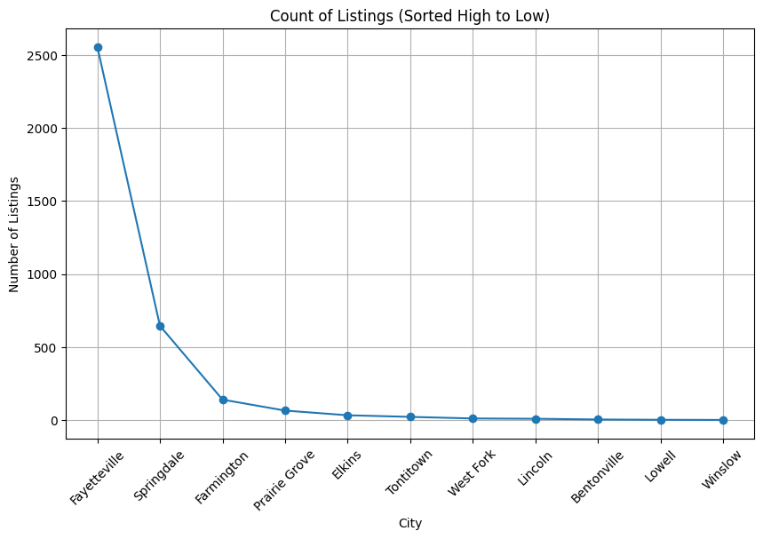
Market Structure
Total of 11 cities recorded in Dataset
Tontitown, Lowell, Bentonville, Farmington, Fayetteville, Prairie Grove, Springdale, West Fork, Elkins, Winslow, and Lincoln
Market Consolidation:
Two main cities holding majority of listings (3,485 after cleaning)
Fayetteville = 2,553 ~ 73.3% of listings
Springdale = 646 ~ 18.5% of listings
Other cities = each under 150 listings ~ 8.2% of listings

Slide 10
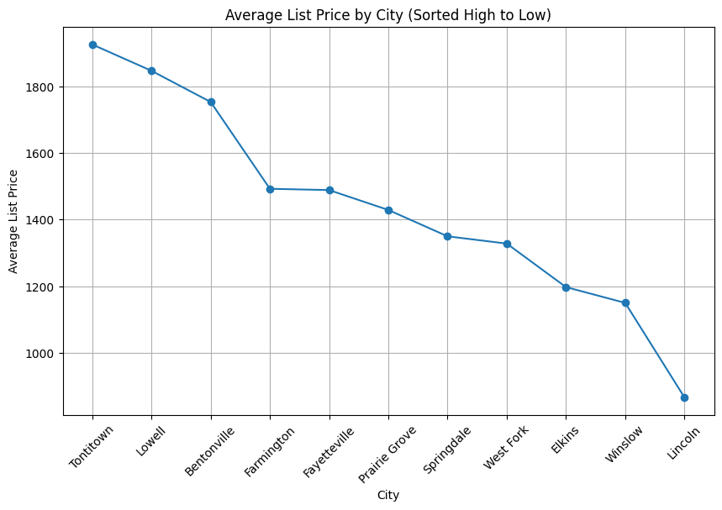
Market Structure
Price tiers:
Average listing price = $1,460
Premium Markets: Tontitown, Lowell, Bentonville
Mid-Markets: Fayetteville, Farmington, Prairie Grove, Springdale
Value Markets: Elkins, Winslow, West Fork, Lincoln

Slide 11
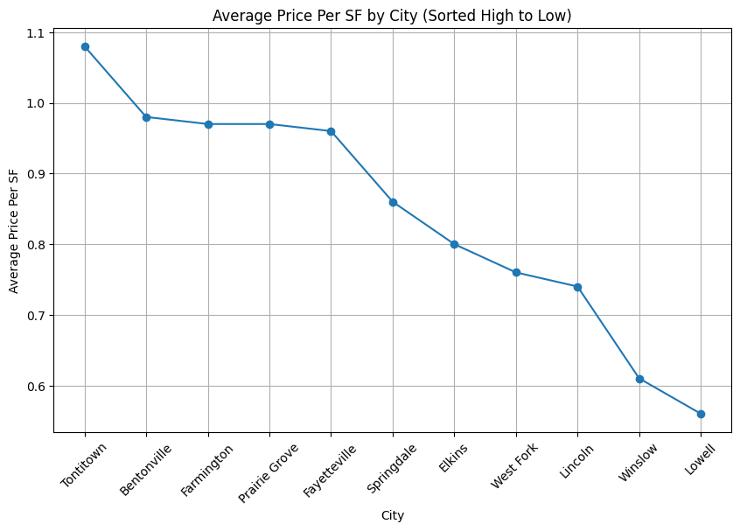
Market Structure
Price per square foot:
Average = $0.94
Highest: Tontitown
Mid-Range: Prairie Grove, Farmington, Fayetteville, Bentonville
Lowest: Lowell

Slide 12
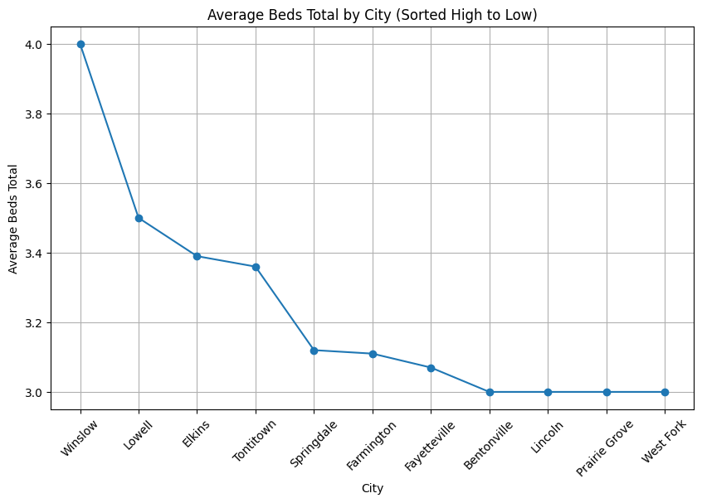
Property Characteristics
Bedroom Distribution:
Average = 3.08 bedrooms
Range = 1-6 bedrooms
Most cities average between (3.4 -3)
Outliers are Winslow and Lowell (above 3.4)
Square Footage:
Mean = 1,596 sq ft
Range = 500 – 7,200 sq ft
Standard deviation = 505 sq ft

Slide 13
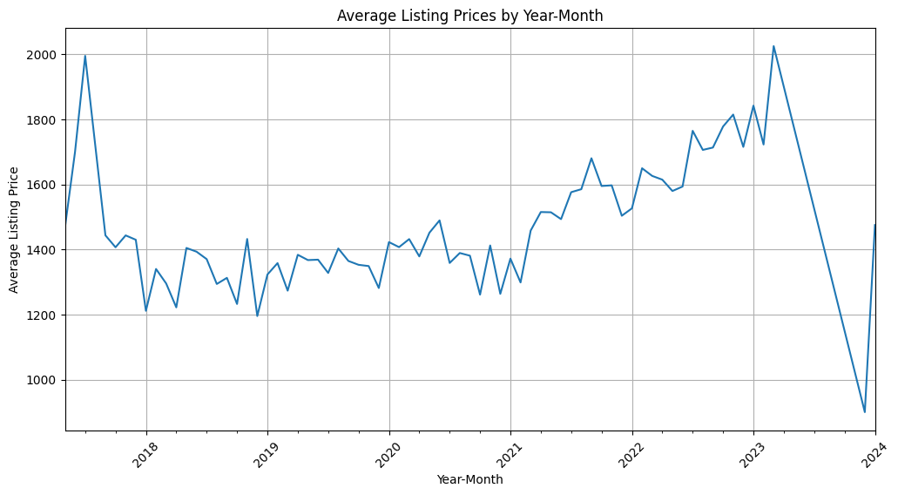
Price Trends
Overall Trends:
Base Period (2018-2020): Relatively Stable
Growth Period (2020-2023): Significant appreciation
Price Statistics:
Median listing price = $1,400
Range = $550 - $7,200
Standard deviation = $475

Slide 14

Initial Patterns + Market Implications
Inverse relationship between size and price per square foot
Bedroom count correlations with total price
Market Concentration:
Dominated by university/urban areas
Limited inventory in smaller markets
Price Dynamics:
Clear market segmentation
Premium for urban locations
Recent market volatility suggest changing conditions
Property Standards:
3-Bedroom format dominates
Significant Size variations between markets

Slide 15
Forming Hypotheses
1. Price-Size Relationship
Larger properties have lower prices per square foot
Economic theory of economies of scale in housing
2. Location Premium Analysis
Rental prices vary significantly between NWA cities
Urban economic theory of location-based pricing
3. Seasonal Market Analysis
Rental prices show seasonal patterns
4. Bedroom Premium Analysis
Bedrooms command a premium beyond square footage
Theory or premium for separated living spaces

Slide 16
Data Analysis
1. Size-Price Analysis
Linear regression
Variables = Heated SF and Price_Per_SF
2. Geographic Analysis
ANOVA testing
Variables = Town and List Price
3. Seasonal Analysis
Time series decomposition
Seasonal Index calculation
Monthly averaging
Variables = Month and List Price
4. Bedroom analysis
Multiple regression
Interaction testing
Variance decomposition
Variables = Heated SF, Beds Total, and List Price

Slide 17
Testing Results: Size-Price Relationship
H0: No relationship between property size and price per square foot
Negative correlation was confirmed with significant p-value, rejecting HO
Coefficient shows for each additional square foot of living space, the price per square foot decreases by $0.0002
Larger Properties are most cost-effective per square foot
Relationship is statistically significant but moderate in magnitude
Results strongly support the economic theory of economies in scale in residential properties

Slide 18
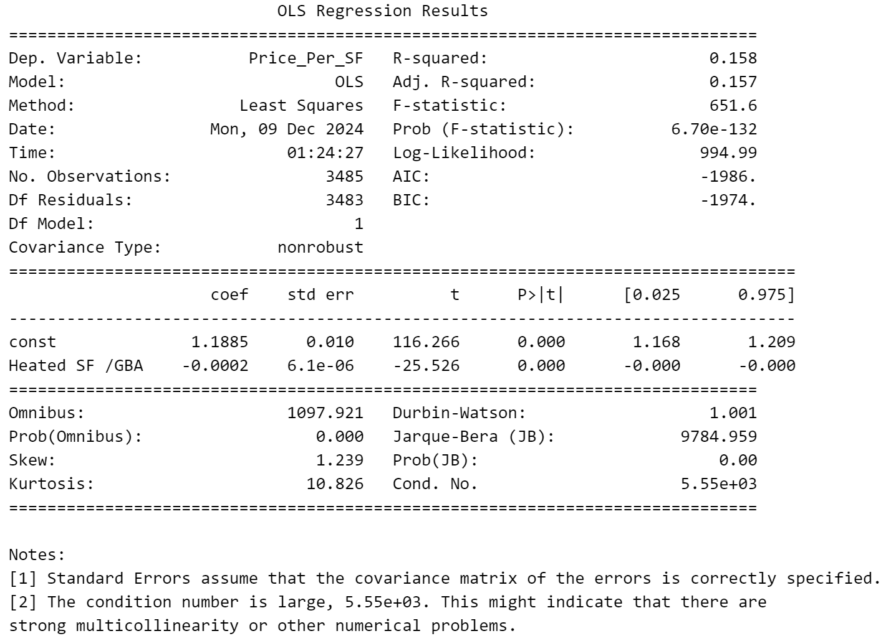
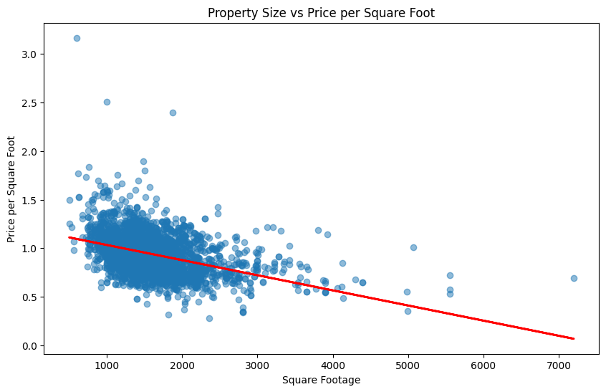
Testing Results: Size-Price Relationship

Slide 19
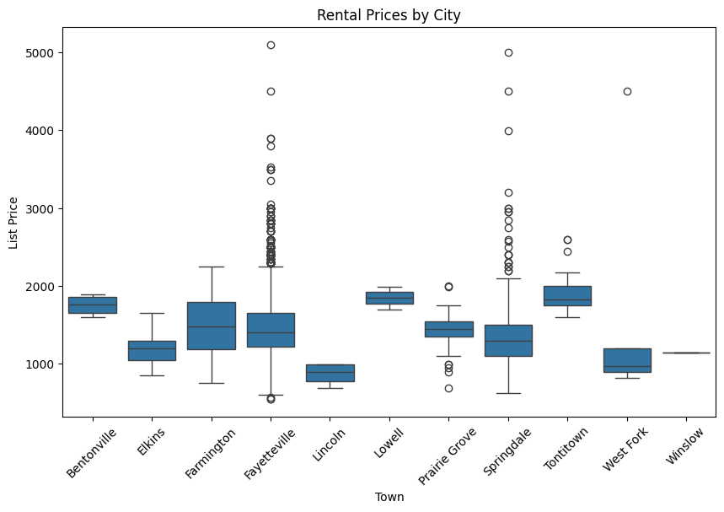
Testing Results: Geographic Variation
H0: No significant price difference between cities
Significant differences found with p-value, rejecting H0
Significant price premiums in more developed areas (e.g., Fayetteville, Bentonville)
Suggests a ‘price floor’ in each market but more flexibility at upper end
Results support traditional urban rent gradient theory

Slide 20
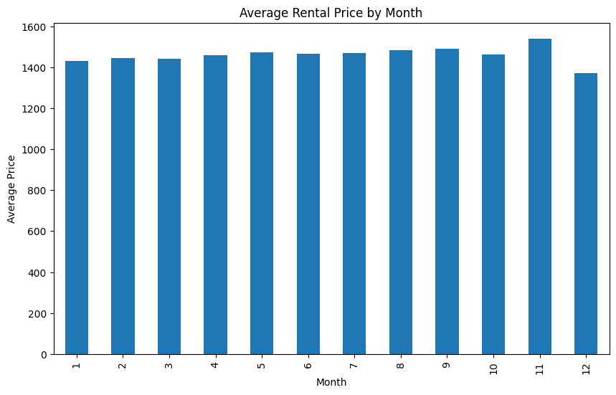
Testing Results: Seasonal Effects
H0: No seasonal pattern in rental prices
Found weak but present seasonal impact, enough to reject H0
Still can takeaway:
November price peak indicates possible market timing opportunities
Seasonality varies little across difference town markets

Slide 21

Testing Results: Bedroom Value
H0: Bedrooms add no value beyond square footage
Rejected H0 with a significant p-value and confirmed bedrooms add value to listing prices independently
Base square footage of $0.56 per sq ft maintain independent value
Beds Total coefficient indicates for each additional bedroom on a listing, the listing price increases by $60.12
Supports theory of a premium on separate living spaces

Slide 22
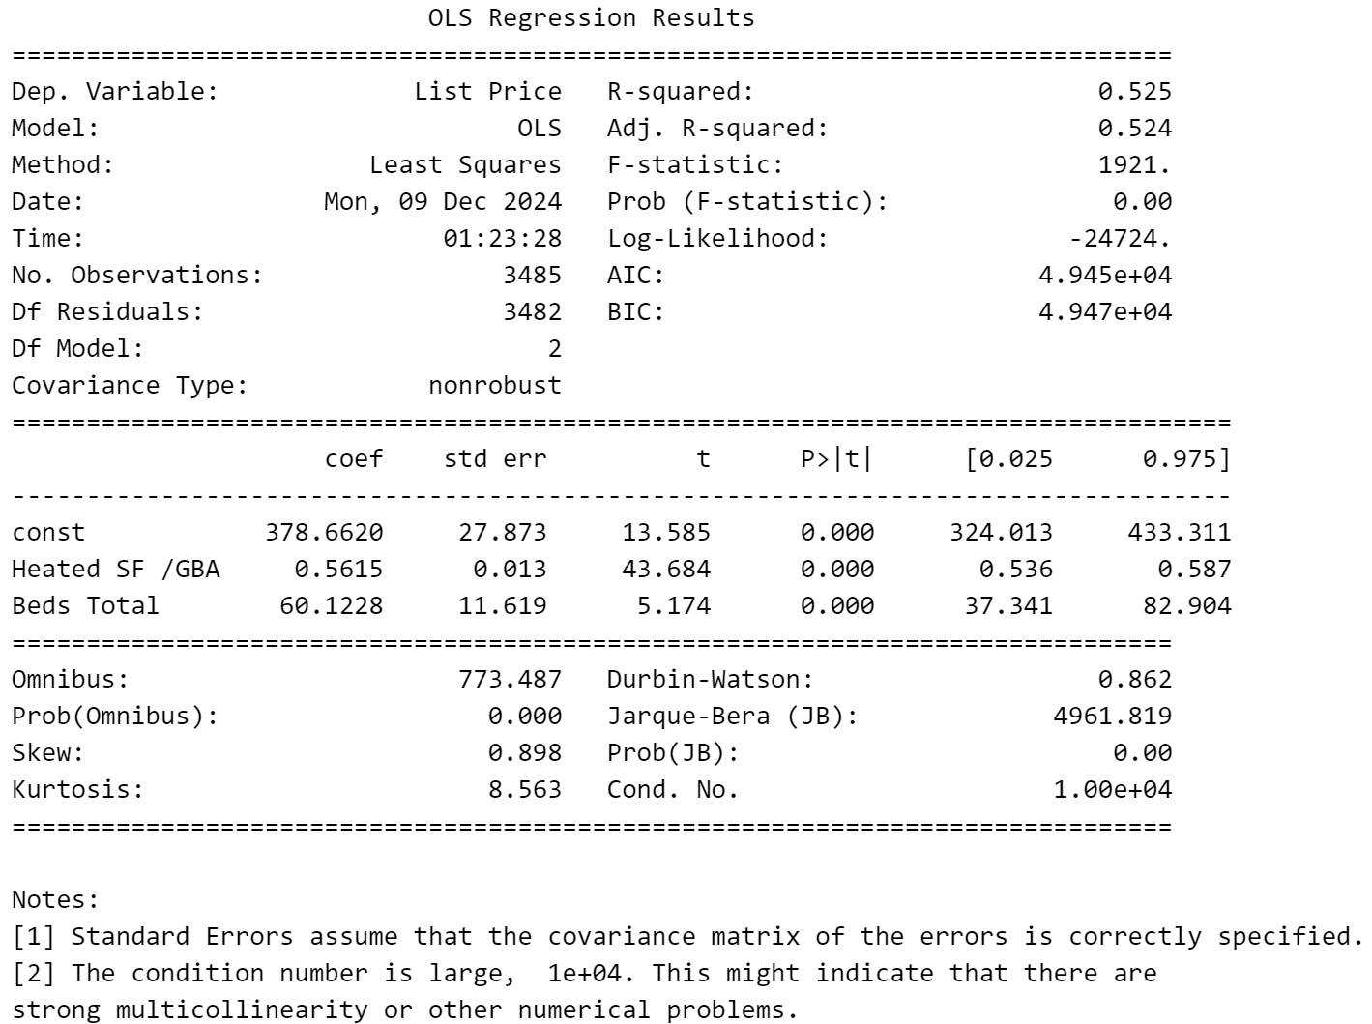
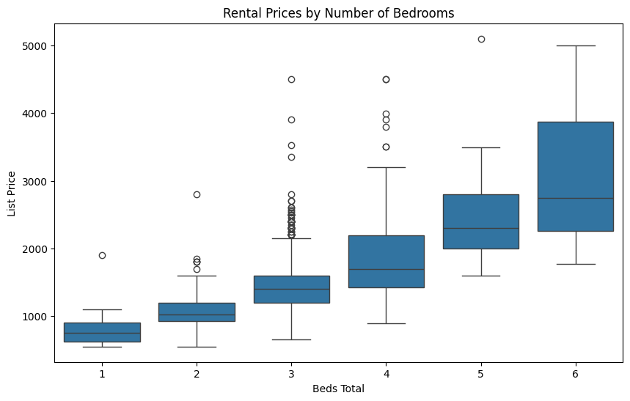
Testing Results: Bedroom Value

Slide 23
Concluded Findings
Market demonstrates rational pricing behavior
Location is the primary price determent
Size shows clear economies of scale
Bedroom count adds independent value, not only through price per square foot

Slide 24
Implications for Property Owners + Managers
Pricing Strategy:
Consider size-based price adjustments
Implement location-based price adjustments
Value the bedroom count outside of square footage
Property Investment:
Focus on location quality over size
Consider bedroom additions in renovations
Balance total size with functional space division
Account for seasonal timing in property acquisition

Slide 25
Implications for Market Participants
Renters should keep in mind:
Larger properties offer better value per square foot
Location premium is a significant consideration
Timing can affect rental rates marginally
Additional bedrooms come with premium pricing
Developers should keep in mind:
Location selection is crucial for pricing power
Bedroom count significantly impacts rental potential
Size efficiency matters more than absolute size
Seasonal timing has limited impact on returns

Slide 26
References

